Slide 1

Presentation Points
This slide presentation template is meant to help you create a visual aid that supports your talking points. Your slides are NOT your presentation – You are.
Include ONLY essential information. Remember, less is more.
Consider these presenting points:
Fonts should be at least 28pt
Never read your slides
Dark backgrounds are easier to read
Animate your body not your slides
When building bullets, only use 1 level
Use diagrams and graphs instead of text

Slide 2
Fonts and Colors
Arial for all type
Fund Assembly brand colors
Use bold and larger type for emphasis.
Keep type at least 28pt for readability.
To add manually, select Design and click the arrow below the colors window (hover over window to see arrow). Then select colors > customize colors. Use Hex values listed below.
Arial Regular
A B C D E F G H I J K L M
N O P Q R S T U V X Y Z
a b c d e f g h i j k l m
n o p q r s t u v x y z
1 2 3 4 5 6 7 8 9 0
Arial Bold
A B C D E F G H I J K L M
N O P Q R S T U V X Y Z
a b c d e f g h i j k l m
n o p q r s t u v x y z
1 2 3 4 5 6 7 8 9 0
#4197B5
# DB151E
#245F8F
#883E58
#332D4C
#51826E
#DB9B42

Slide 3
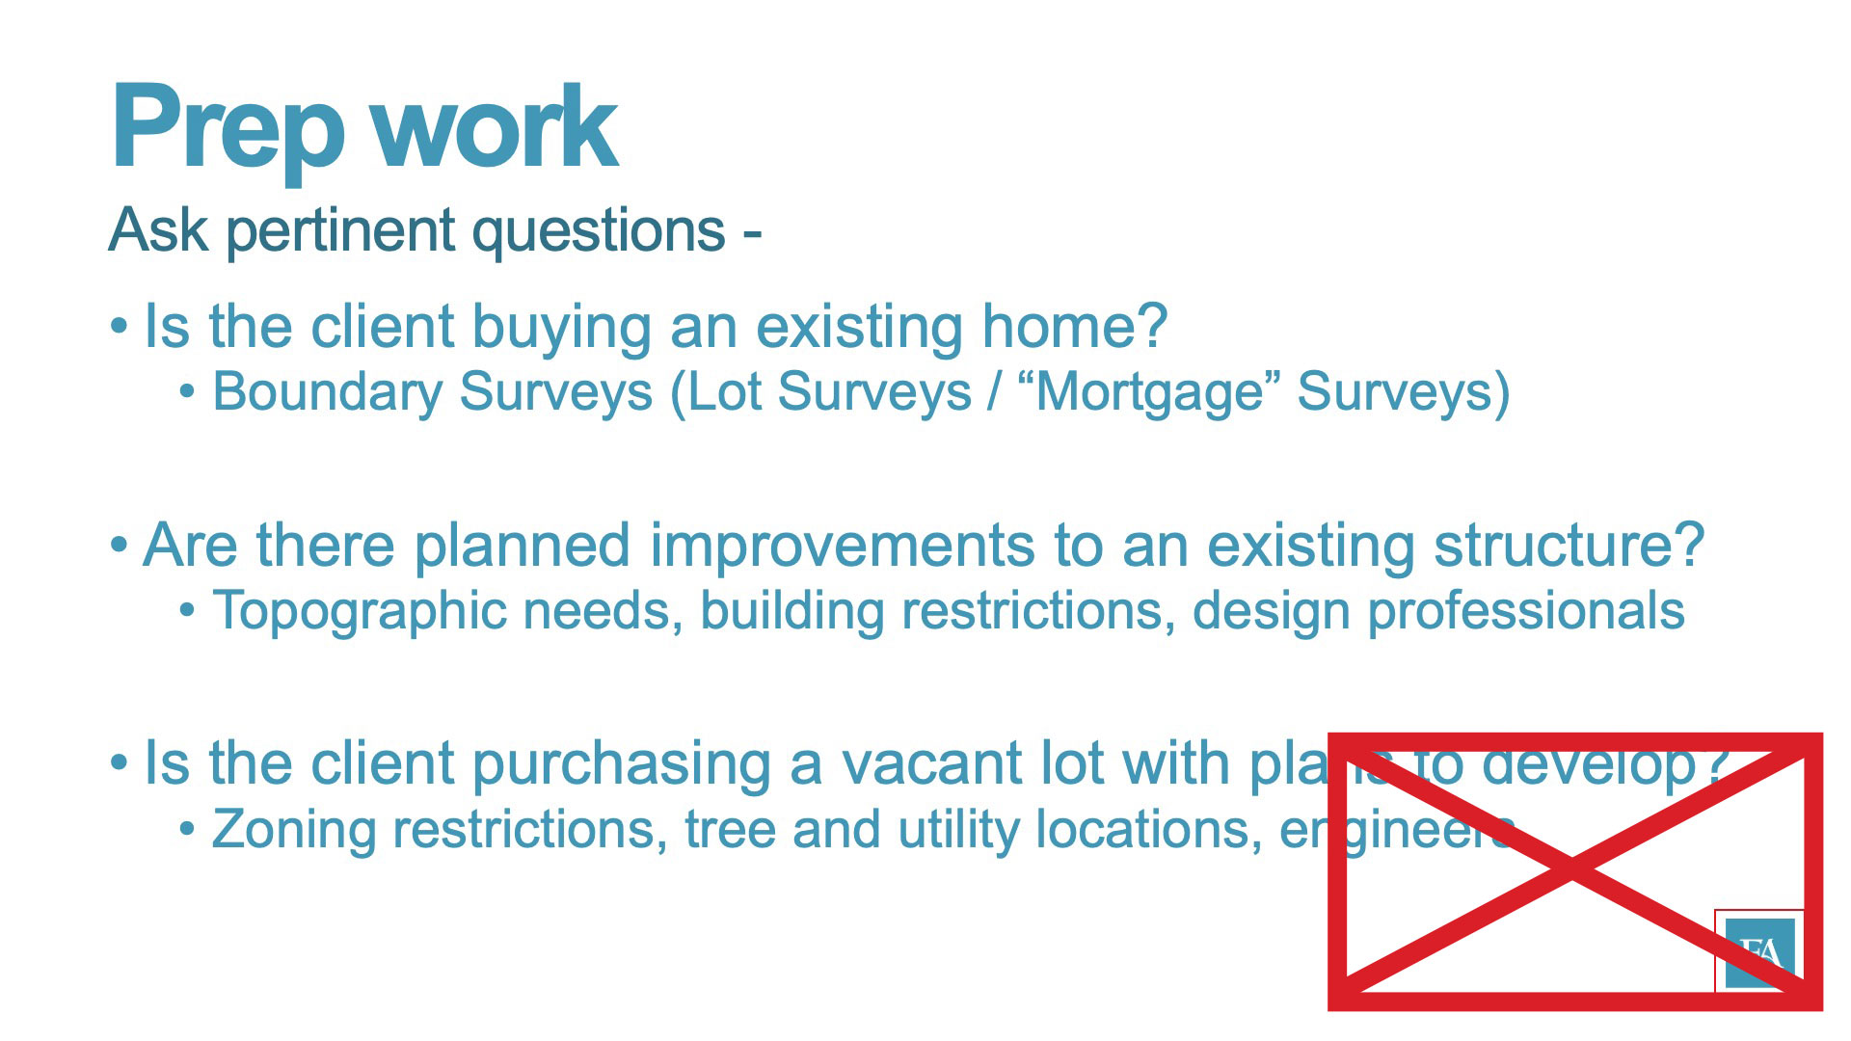
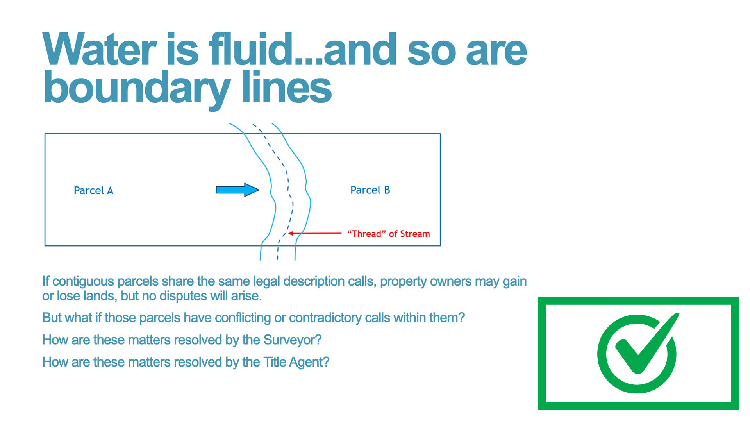
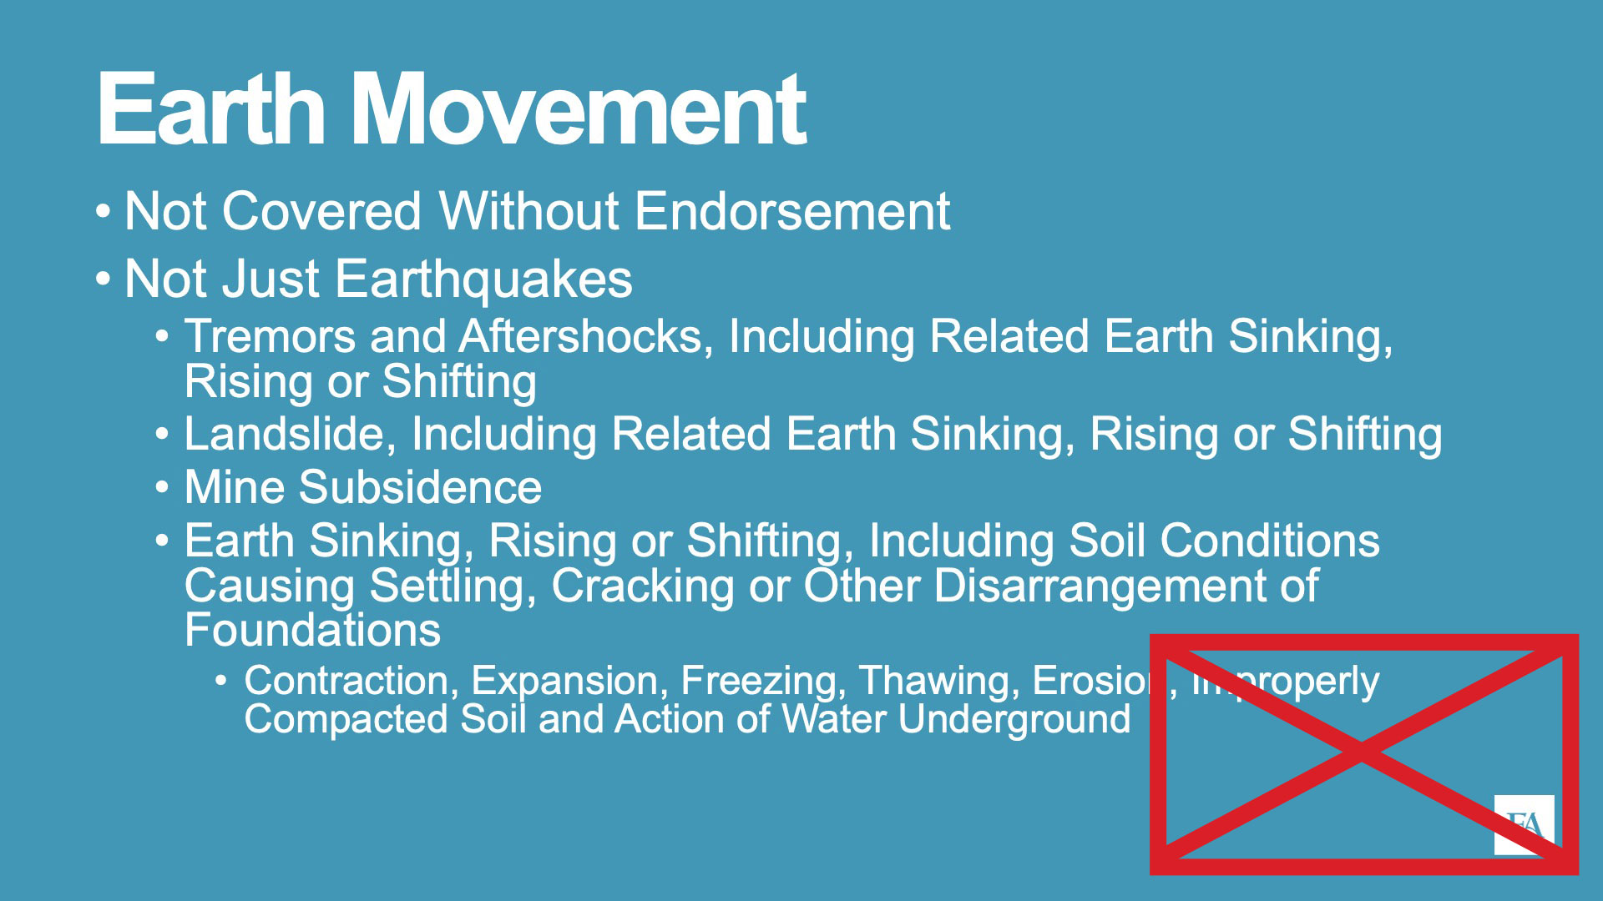
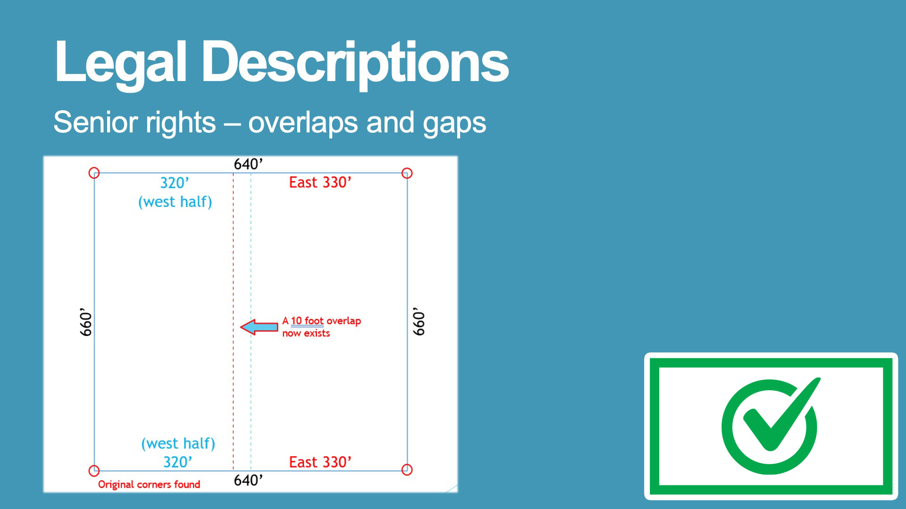
Layout
Avoid placing content
in the lower right corner. Live Online broadcast includes a PIP overlay
of speaker that will obscure content.

Slide 4
Presentation Title goes here
Subhead goes here
Presenter’s Name
Presenter’s Title

Slide 5
Section Title
Subtitle of section divider

Slide 6
Section Title
Subtitle of section divider

Slide 7
Text only slide
Use this slide when 1 column of text is needed

Slide 8
Text only slide
Use this slide when 2 columns of text are needed

Slide 9
Text only slide
Use this slide when 1 column of text is needed

Slide 10
Text only slide
Use this slide when 2 columns of text are needed

Slide 11
Image only slide
Use this slide when 1 landscape oriented image is needed

Slide 12
Image only slide
Use this slide when 2 images are needed

Slide 15
Image only slide
Use this slide when 1 landscape oriented image is needed

Slide 16
Image only slide
Use this slide when 2 images are needed

Slide 18
Mixed Content slide
Use this slide when 1 column of text and 1 image is needed

Slide 19
Mixed Content slide
Use this slide when 1 column of text and 1 image is needed

Slide 20

Thank you
For more information please contact:
Contact Name
Phone number | Email | Web site

