Slide 1

Presentation Points
This slide presentation template is meant to help you create a visual aid that supports your talking points. Your slides are NOT your presentation – You are.
Include ONLY essential information. Remember, less is more.
Consider these presenting points:
Fonts should be at least 28pt
Never read your slides
Dark backgrounds are easier to read
Animate your body not your slides
When building bullets, only use 1 level
Use diagrams and graphs instead of text

Slide 2
Fonts and Colors
Arial for all type
Fund Assembly brand colors
Use bold and larger type for emphasis.
Keep type at least 28pt for readability.
To add manually, select Design and click the arrow below the colors window (hover over window to see arrow). Then select colors > customize colors. Use Hex values listed below.
Arial Regular
A B C D E F G H I J K L M
N O P Q R S T U V X Y Z
a b c d e f g h i j k l m
n o p q r s t u v x y z
1 2 3 4 5 6 7 8 9 0
Arial Bold
A B C D E F G H I J K L M
N O P Q R S T U V X Y Z
a b c d e f g h i j k l m
n o p q r s t u v x y z
1 2 3 4 5 6 7 8 9 0
#4197B5
# DB151E
#245F8F
#883E58
#332D4C
#51826E
#DB9B42

Slide 3
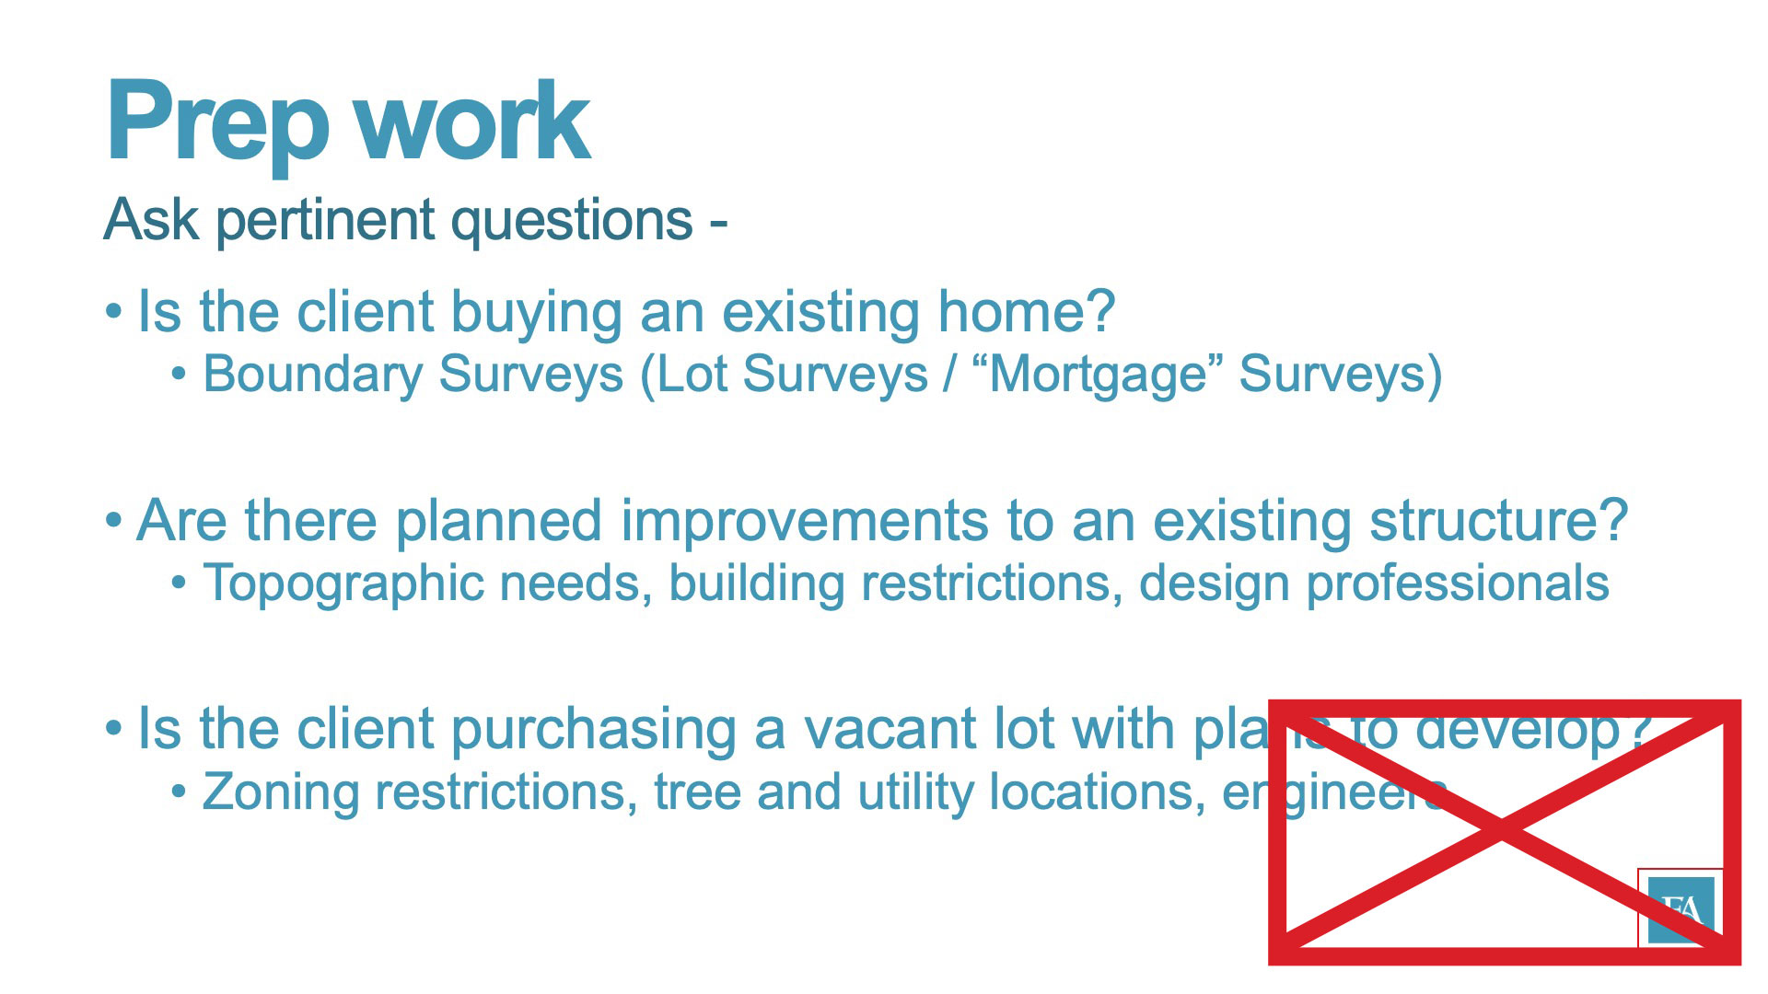
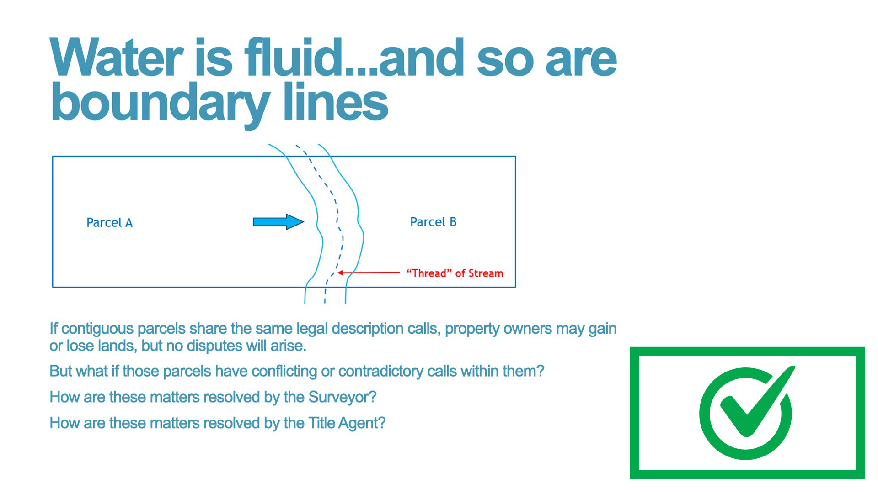
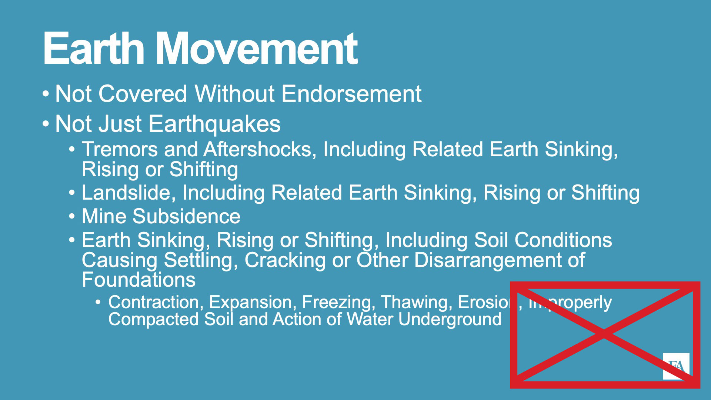
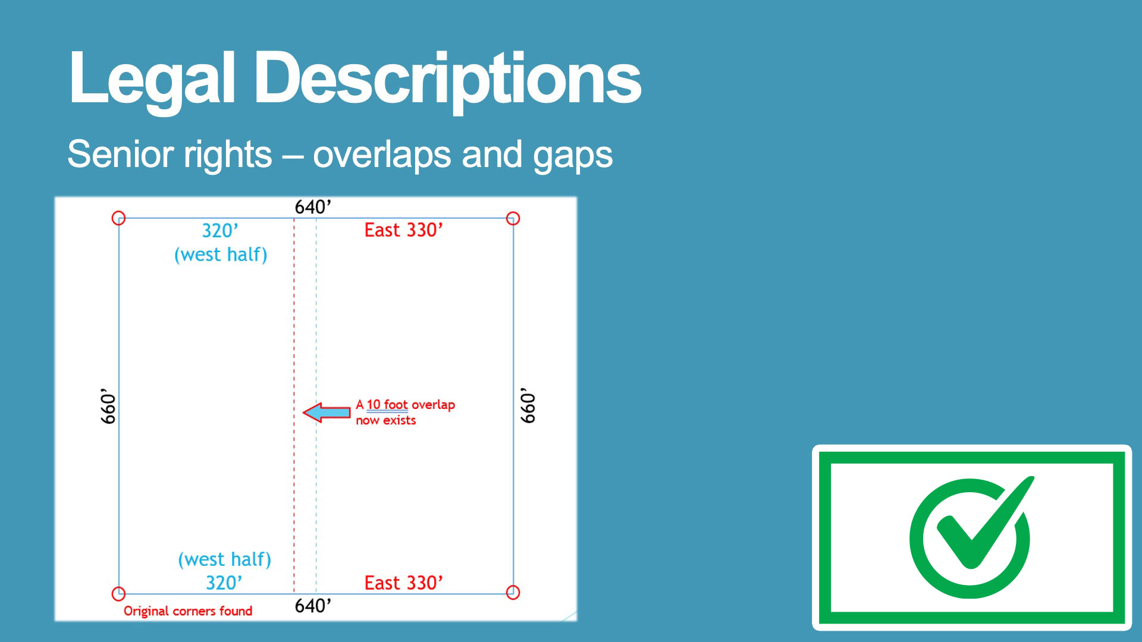
Layout
Avoid placing content
in the lower right corner. Live Online broadcast includes a PIP overlay
of speaker that will obscure content.

Slide 5
Title Slide
Presentation Title goes here
Title - 60pt (or larger) | Bold | Fund Blue
Subhead - 32pt | Not Bold | Fund Blue
Subhead goes here
Name - 32pt | Bold | White
Presenter’s Name
Presenter’s Title
Title - 28pt | Not Bold | White

Slide 6
Section Title
Section Title - 54pt (or larger) | Bold | Fund Blue
Subhead - 30pt | Not Bold | Fund Blue
Subtitle of section divider

Slide 7
Section Title
Section Title - 54pt (or larger) | Bold | White
Subhead - 30pt | Not Bold | White
Subtitle of section divider

Slide 8
Text only slide
Page Head - 60pt | Bold | Fund Blue
Subhead - 32pt | Not Bold | Fund Blue
Use this slide when 1 column of text is needed

Slide 9
Text only slide
Use this slide when 2 columns of text are needed

Slide 10
Text only slide
Use this slide when 1 column of text is needed

Slide 11
Text only slide
Use this slide when 2 columns of text are needed

Slide 12
Image only slide
Use this slide when 1 landscape oriented image is needed

Slide 13
Image only slide
Use this slide when 2 images are needed

Slide 14
Single Large Image – White Background

Slide 15
Single Large Image

Slide 16
Image only slide
Use this slide when 1 landscape oriented image is needed

Slide 17
Image only slide
Use this slide when 2 images are needed

Slide 18
Single Large Image – Blue Background

Slide 19
Mixed Content slide
Use this slide when 1 column of text and 1 image is needed

Slide 20
Mixed Content slide
Use this slide when 1 column of text and 1 image is needed

Slide 21

Beginning of SmartArt Section
Use an icon from the icon library to add interest to section dividers
You can change the color of the icon in the Format Graphic panel, but make sure to keep them consistent
Charts & Graphs with Smart Art
The following slides show examples of information displayed using SmartArt charts and graphs.

Slide 22
Timeline Process
Timeline
Use for displaying chronological data
Colors and graph information can be changed by double clicking

Slide 23

5 Step Process
Processes
Step 1
Step 2
Step 3
Step 4
Step 5
Nequos simus eliquo od molus excessinus, ut ut es rem ut qui que am ad eosam fugiatisti.
Colors and graph information can be changed by double clicking

Slide 24
Pie Chart Data
Pie Chart Data
Use for displaying proportional or percentage data
Colors and graph information can be changed by double clicking
Data Set #1
Data Set #2

Slide 25
Bar Graph Data
Bar Graph Data
Use for displaying proportional or percentage data
Colors and graph information can be changed by double clicking
Data Set #1
Data Set #2

Slide 26
Organizational Data - 1
Organizational Data
Use for displaying groups of ideas
Section 1 Header
Section 2 Header
Section 3 Header
Section 4 Header
Section 5 Header
Section 6 Header

Slide 27
Organizational Data - 2
Organizational Data
Use for displaying groups of ideas
Subject | Descriptor | Subset

Slide 28

Thank You Slide
Thank you
For more information please contact:
Contact Name
Phone number | Email | Web site
Name - 48pt | Bold | Blue
Contact Info - 28pt | Not Bold | Blue

Slide 29







































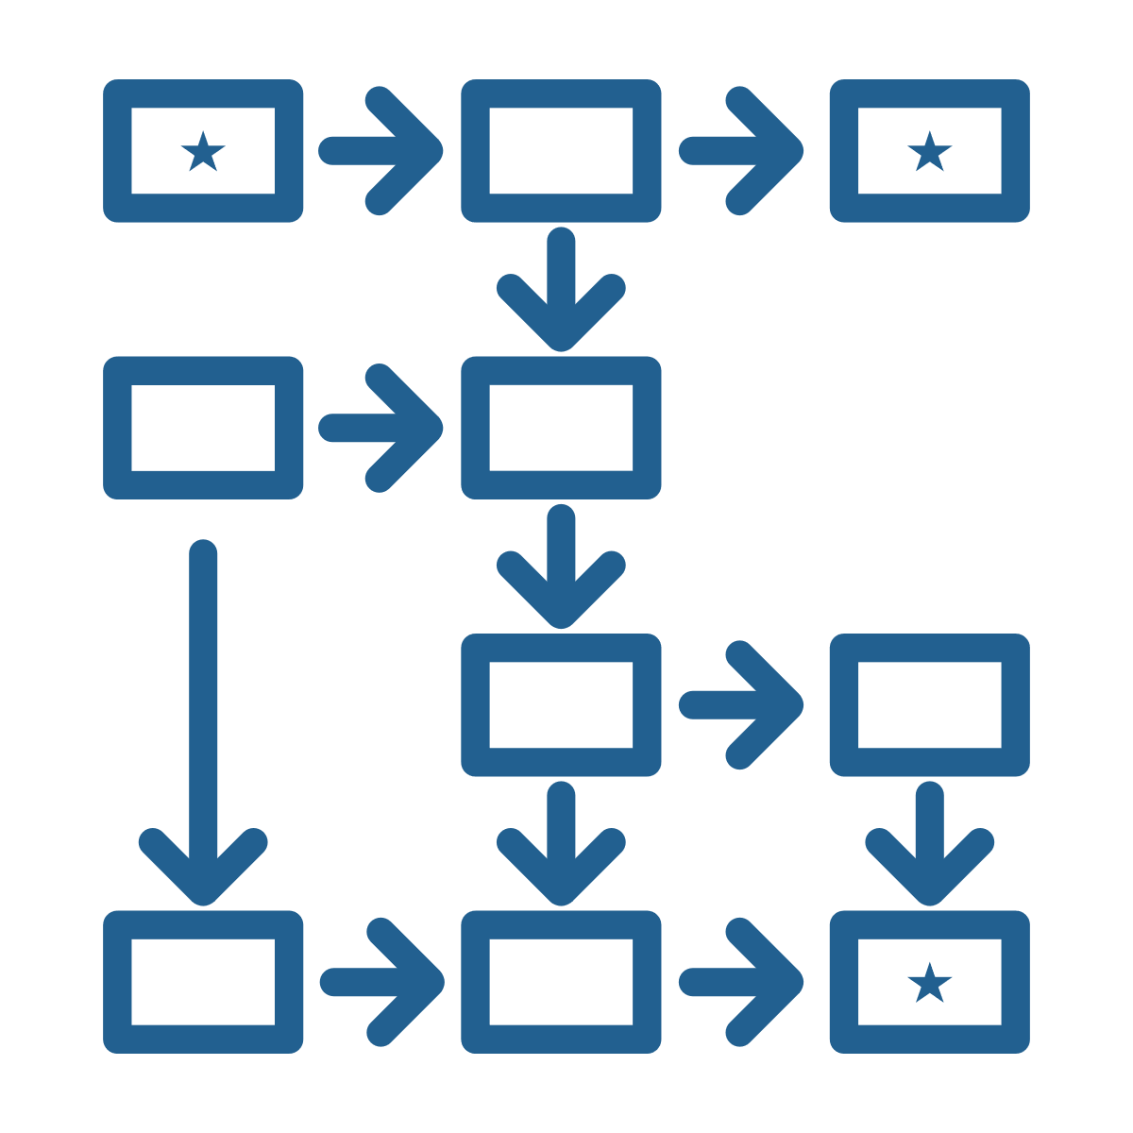














































































































































































































































































































Icon Library
Icon Library
Use these approved icons to add interest and visual clarification to your presentations. Current image size is too small to be seen in a large room so make sure to enlarge these graphics by at least 300%.

